Slide 1
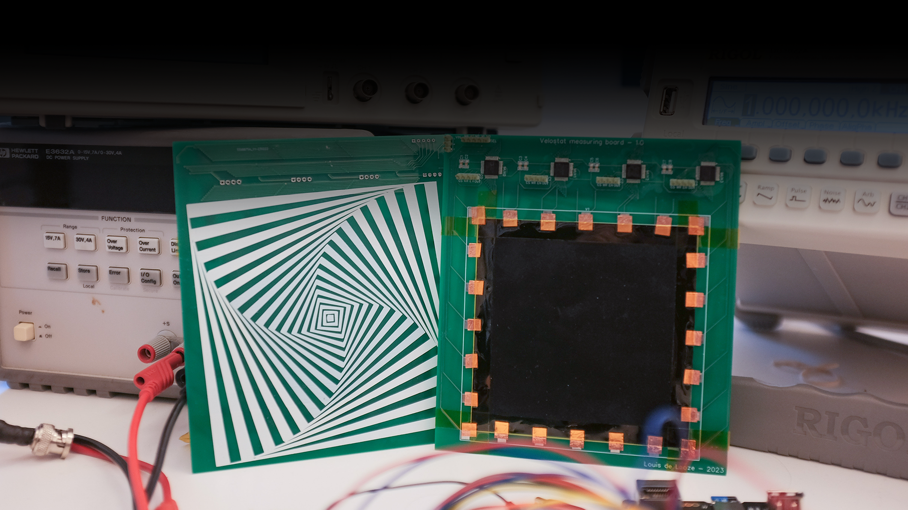
DEVELOPMENT OF AN INSTRUMENTATION SYSTEM FOR THE CHARACTERISATION OF VELOSTAT MATERIAL
Louis de Looze
Examiner: Martin Ekström
Supervisors: Saad Abdullah, Abdelakram Hafid

Slide 2
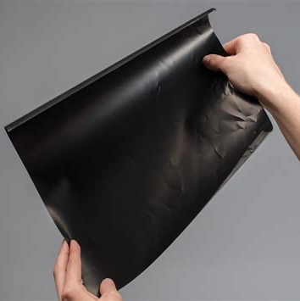
Velostat?
Introduction
Notes:
Who has heard about Velostat except my supervisor?
Carbon impregnated polyethylene
Used for ESD safe packaging
Also used for sensors
Image: https://www.adafruit.com/product/1361

Slide 3
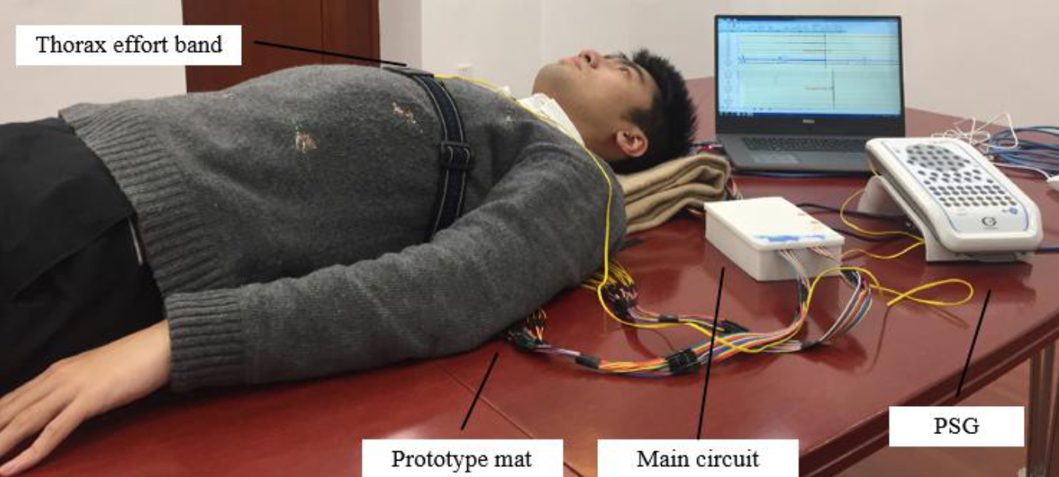
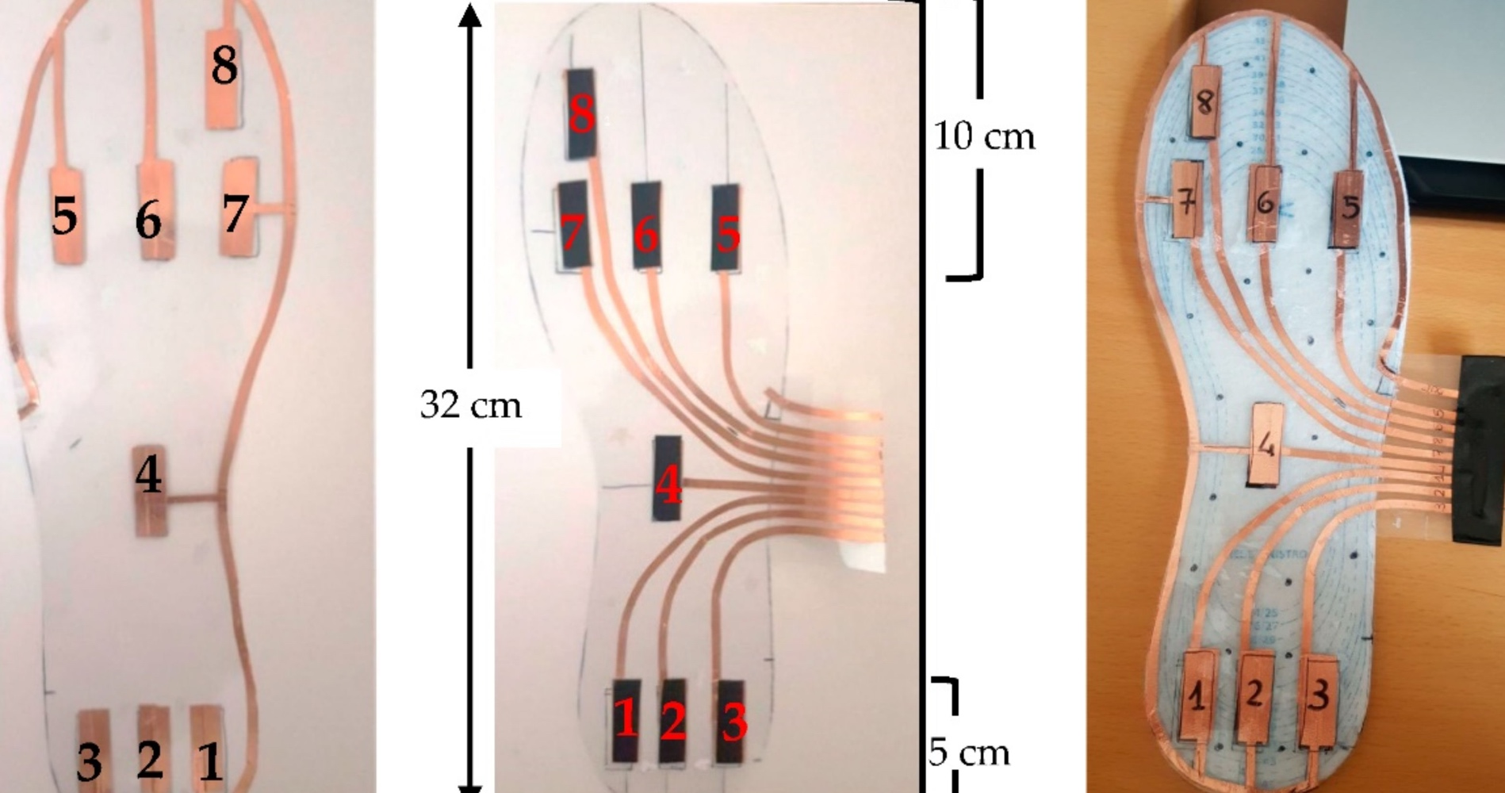
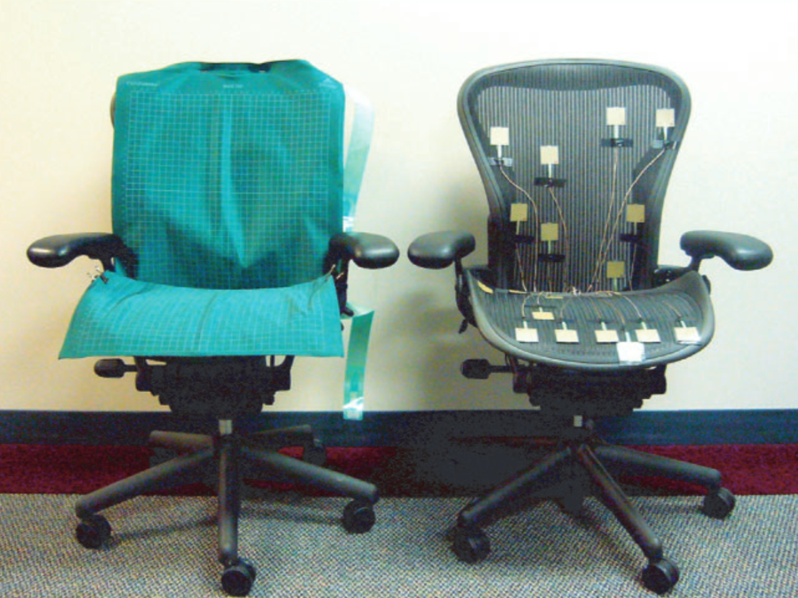
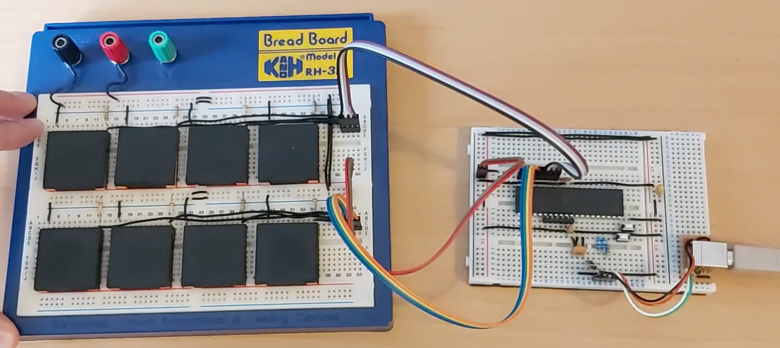
Introduction
Notes:
– sleep monitoring (e.g.,[1]);
– posture monitoring (e.g.,[2], [3]);
– floor‐based foot pressure measuring (e.g.,[4]);
– shoe insole pressure measuring (e.g.,[5], [6]);
– interactive sensing floors (e.g.,[7]);
– Musical Instrument Digital Interface (MIDI) controllers (e.g.,[8]).

Slide 4
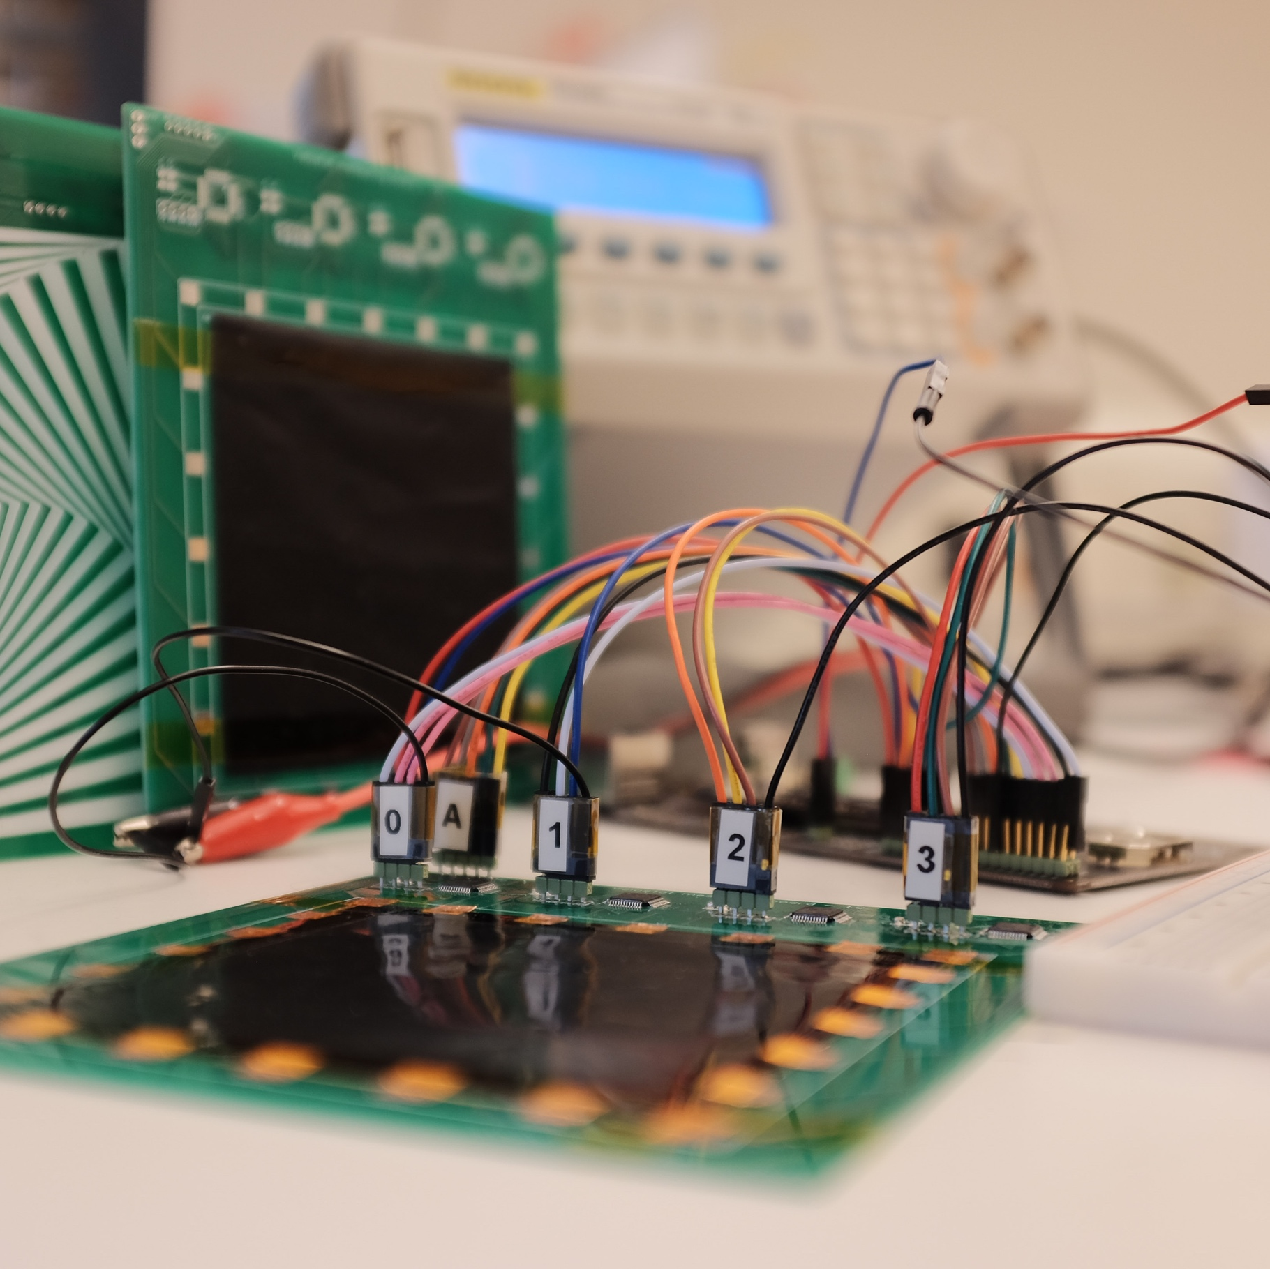
Instrumentation system?
Introduction
Notes:
Why instrumentation system?
Researchers always build test sustem from zero → time and resource consuming
Sometimes no technical knowledge
Insturementation system should be used by everybody

Slide 5
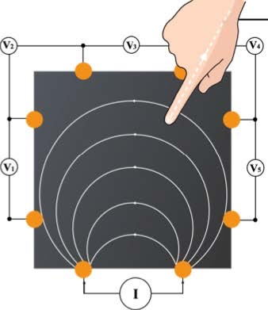
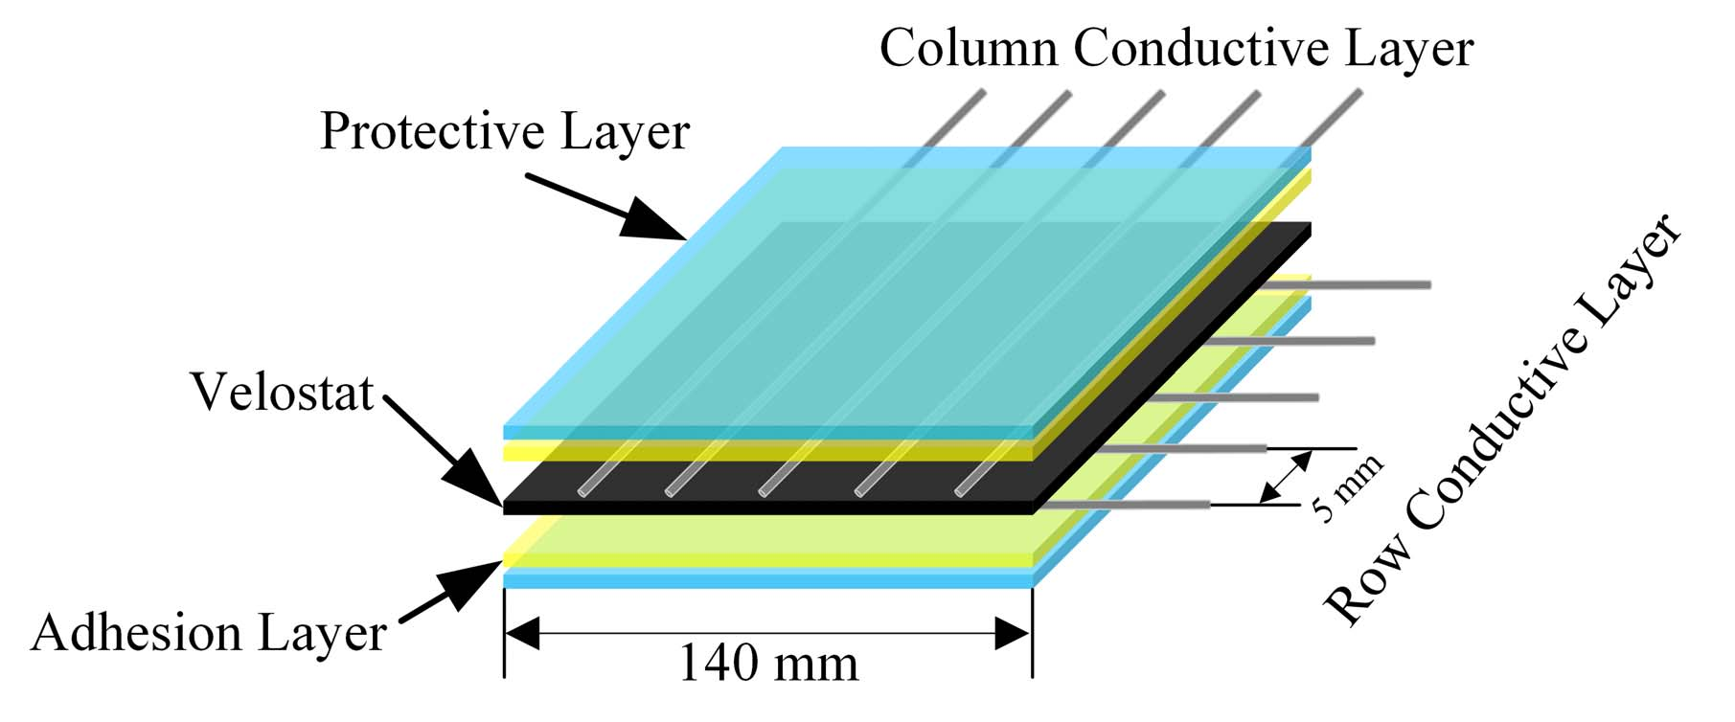
Current State
Background
Notes:
How velostat?
Looking at current literature of velostat based tactile sensors
2 distinct methods: borders and velostat matrix
one uses the complete sheet as a sensor, other divides the sheet in multiple sensors
We will focus on border based sensors
Y. Zhang, G. Laput, and C. Harrison, “Electrick: Low-cost touch sensing using electric field tomography,” 2017. [Online]. Available: http://dx.doi.org/10.1145/3025453.3025842
L. Yuan, H. Qu, and J. Li, “Velostat sensor array for object recognition,” IEEE Sensors Journal, vol. 22, pp. 1692–1704, 1 2022.

Slide 6
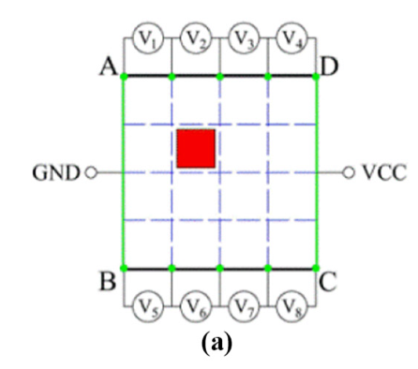
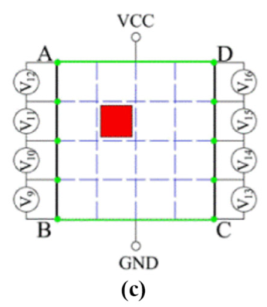
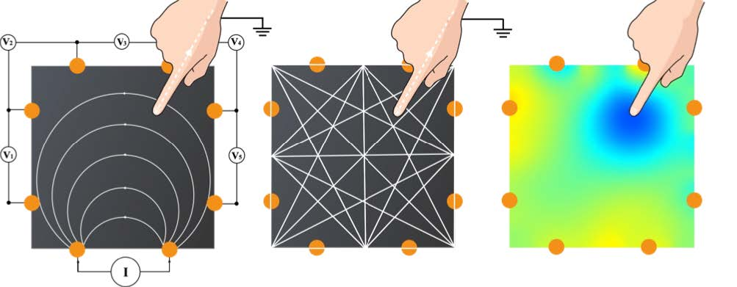
Sensing Principles
Direct Current
Youzhi Zhang et al.
Alternating Current
Yang Zhang et al.
Background
Notes:
When with the border system, a measurement pair and injecting pair of electrodes
The injecting signal can be AC or DC
Both methods extensively researched
Y. Zhang, G. Laput, and C. Harrison, “Electrick: Low-cost touch sensing using electric field tomography,” 2017. [Online]. Available: http://dx.doi.org/10.1145/3025453.3025842
Y. Zhang, Z. Lin, X. You, X. Huang, J. Ye, and H. Wu, “A position‐sensitive electronic skin
based on boundary potential projection theory,” Sensor Review, vol. 40, no. 1, pp. 130–140,
Jan. 2020, ıſſN: 0260‐2288. DOı: 10 . 1108 / SR - 10 - 2019 - 0243. [Online]. Available:
https://doi.org/10.1108/SR-10-2019-0243.

Slide 7
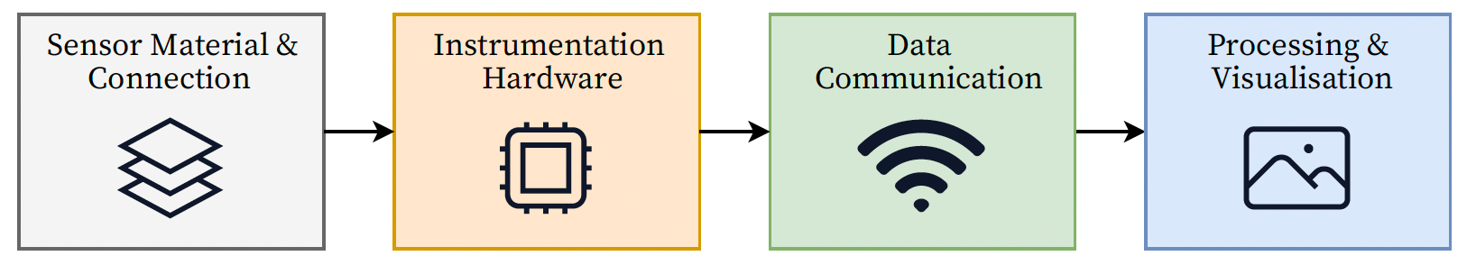
Overview
Implementation and Design

Slide 8
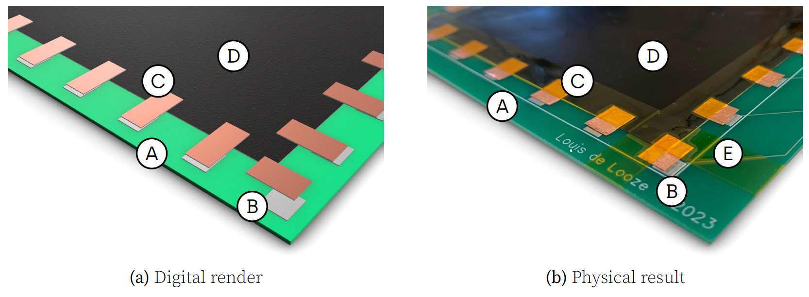
Sensor Material & Connection
Implementation and Design
Notes:
Connections on pcb
Exposed pads
Copper tape and kapton

Slide 9
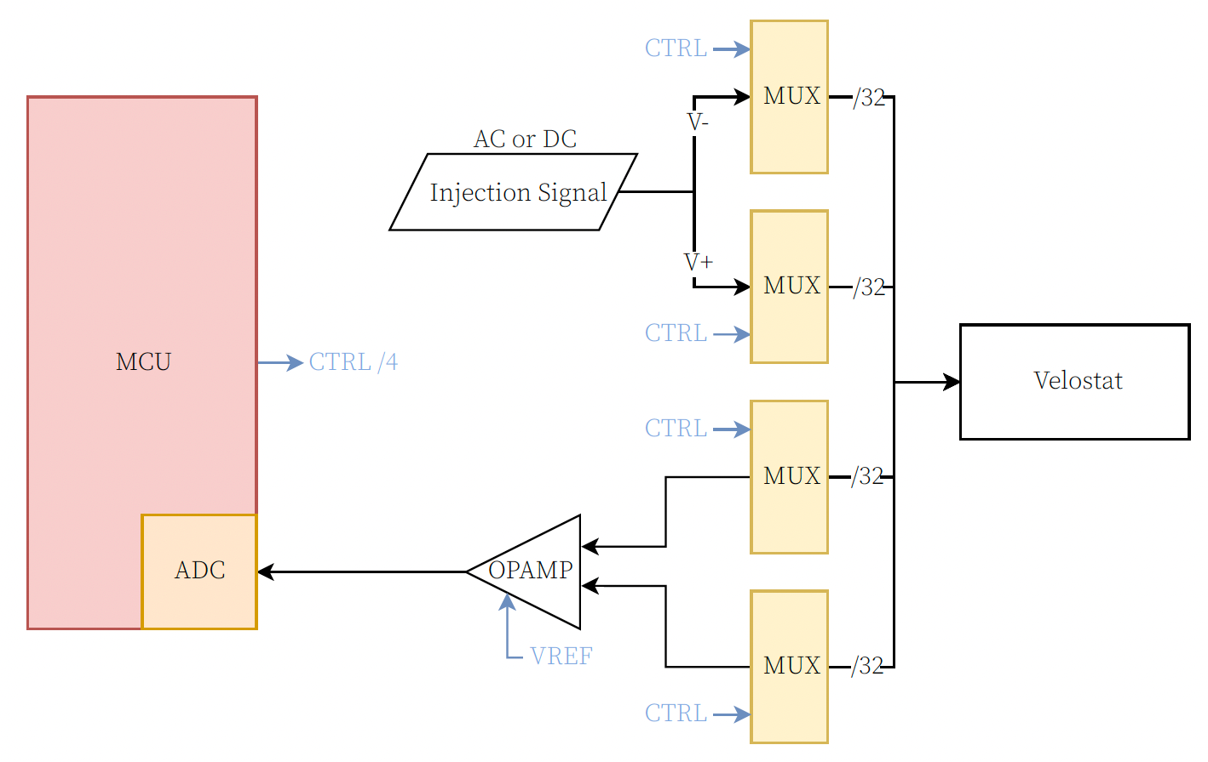
Instrumentation Hardware
Implementation and Design
Notes:
4 multiplexers
upper conencted to injecting signal
lower is connected to opamp
adc digitalises the signal
All mux pins connected to velostat

Slide 10
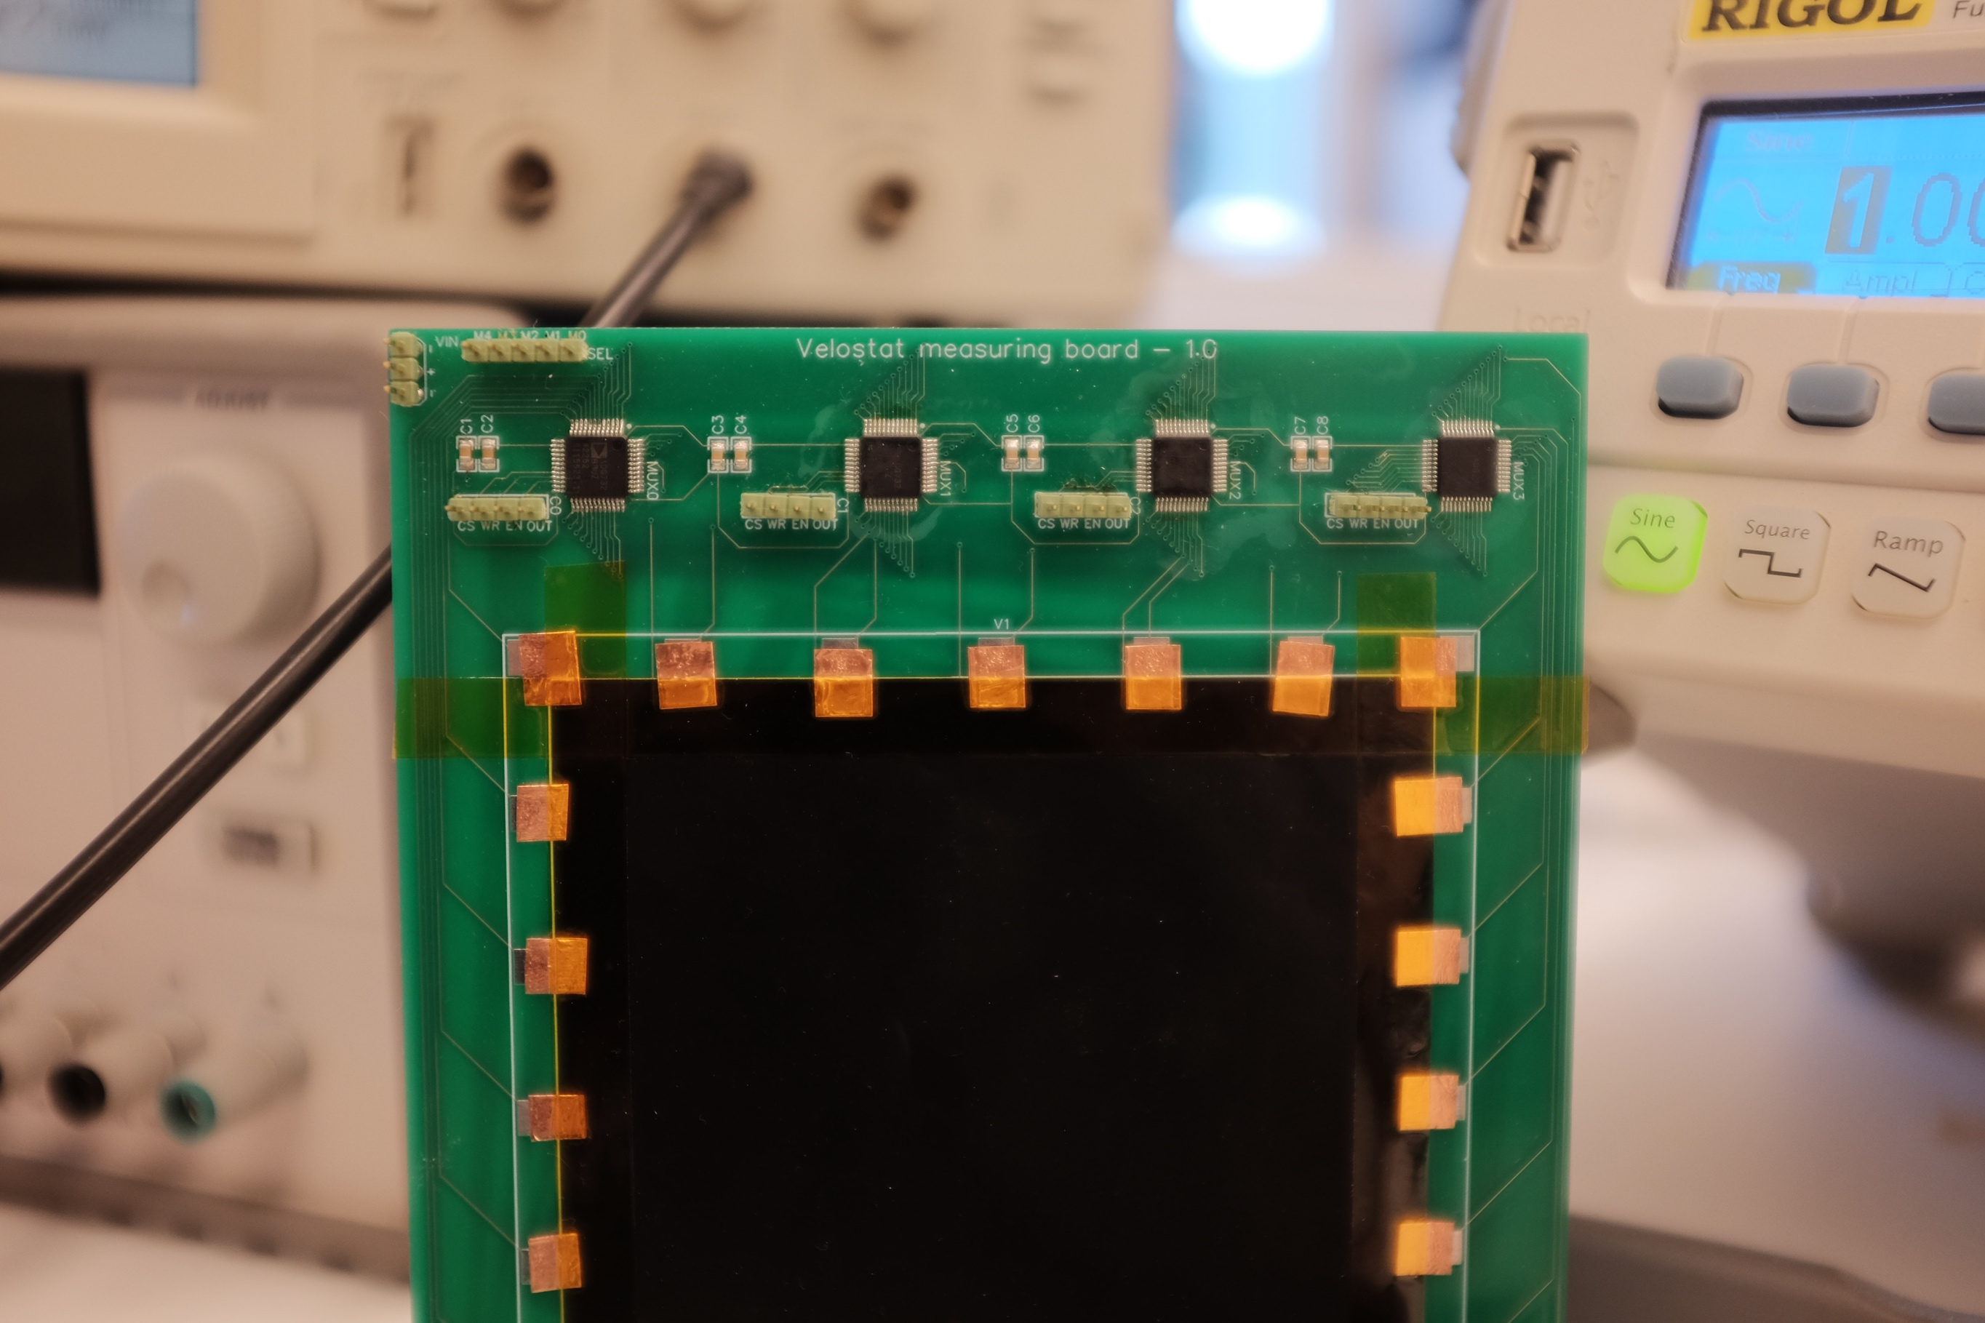
Multiplexers
Implementation and Design
Notes:
Here we can see the custom pcb with muxes

Slide 11
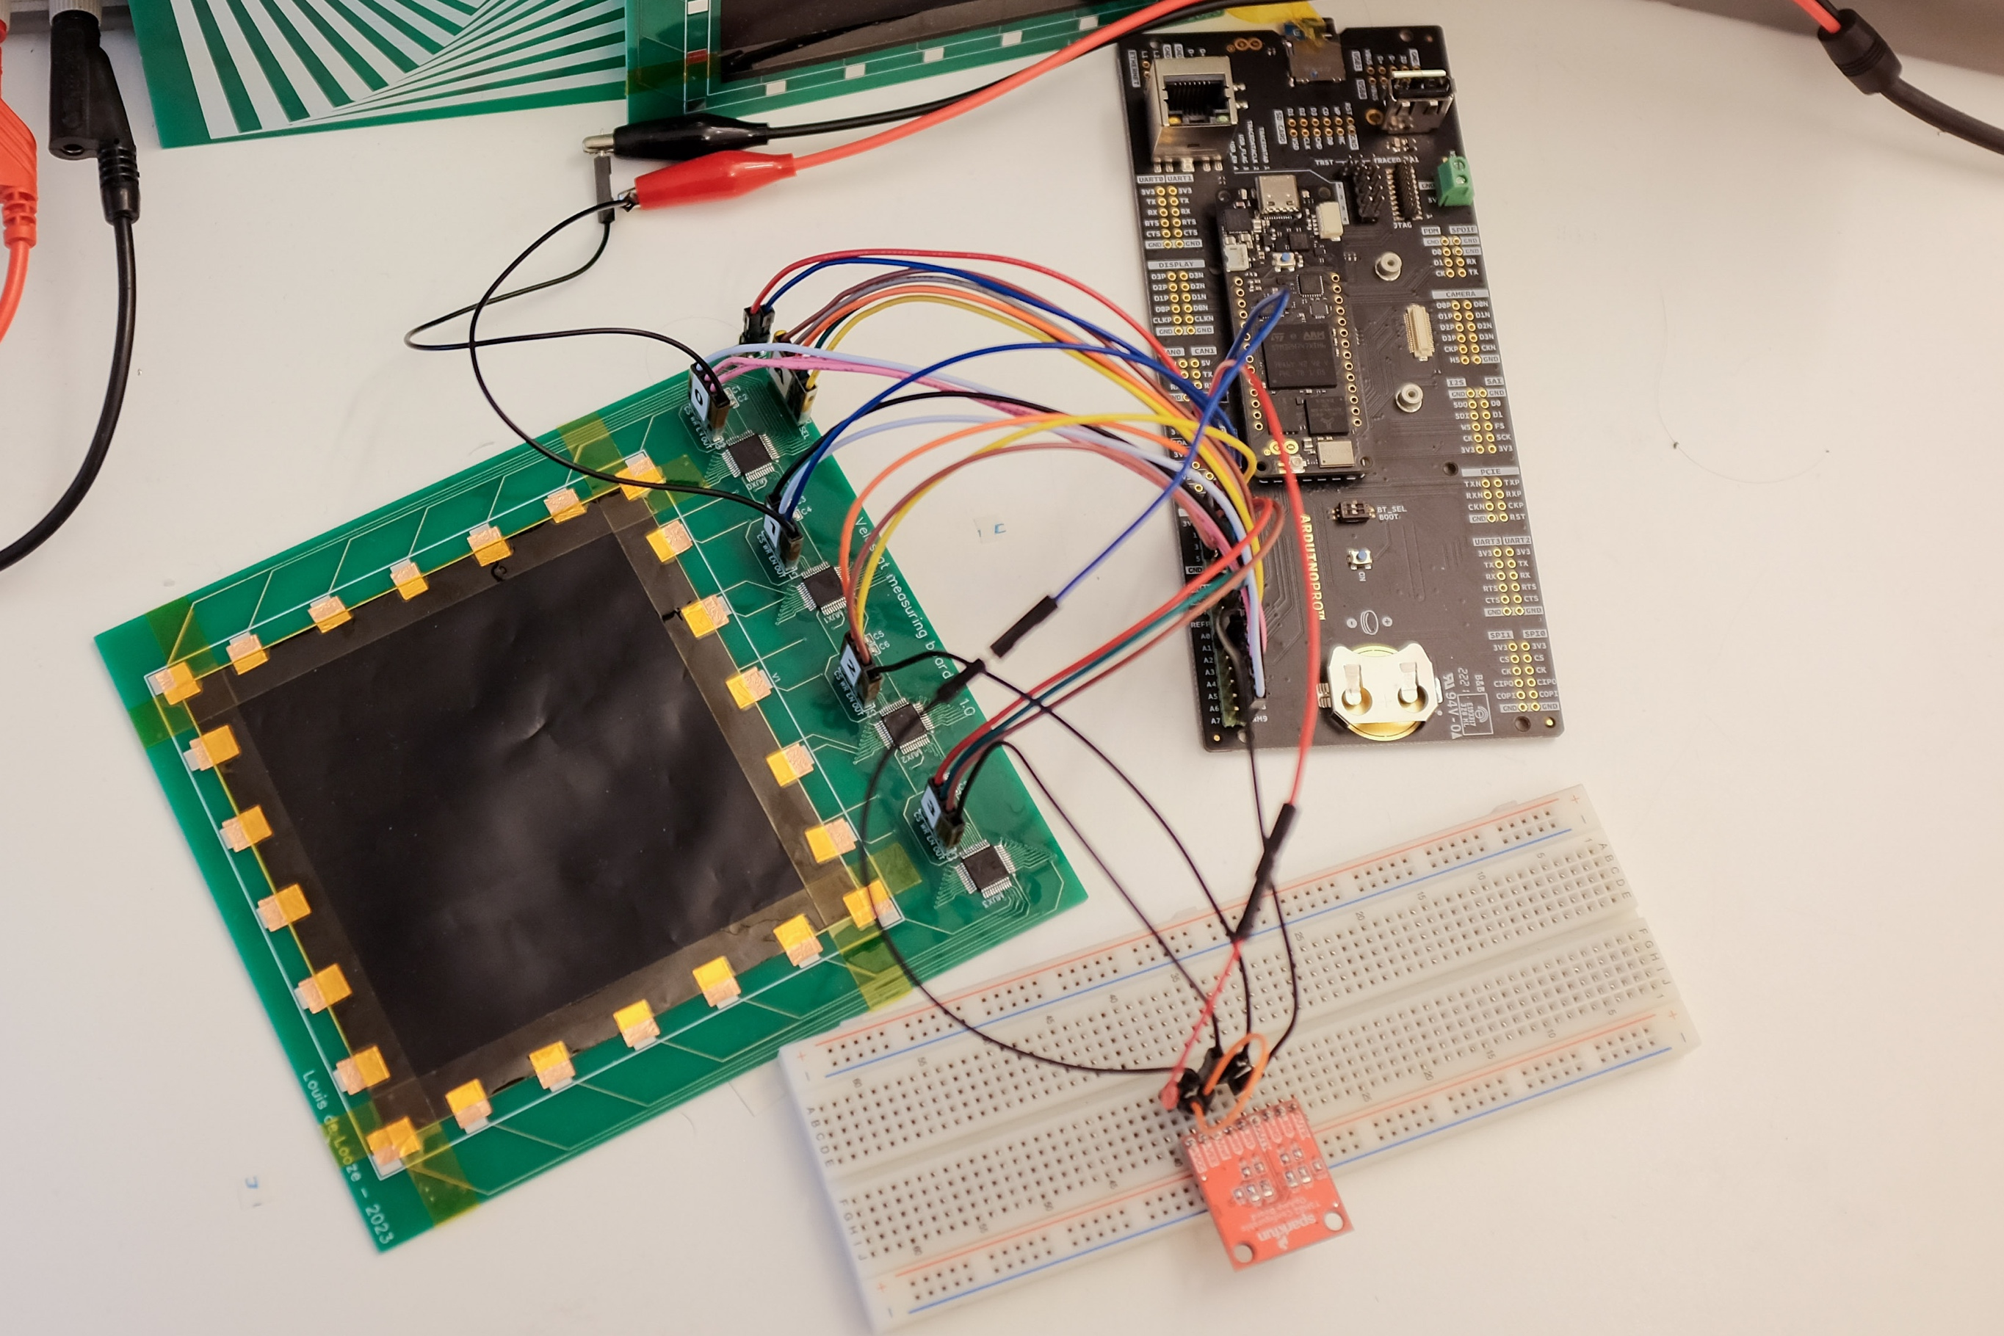
Overview
Implementation and Design

Slide 12
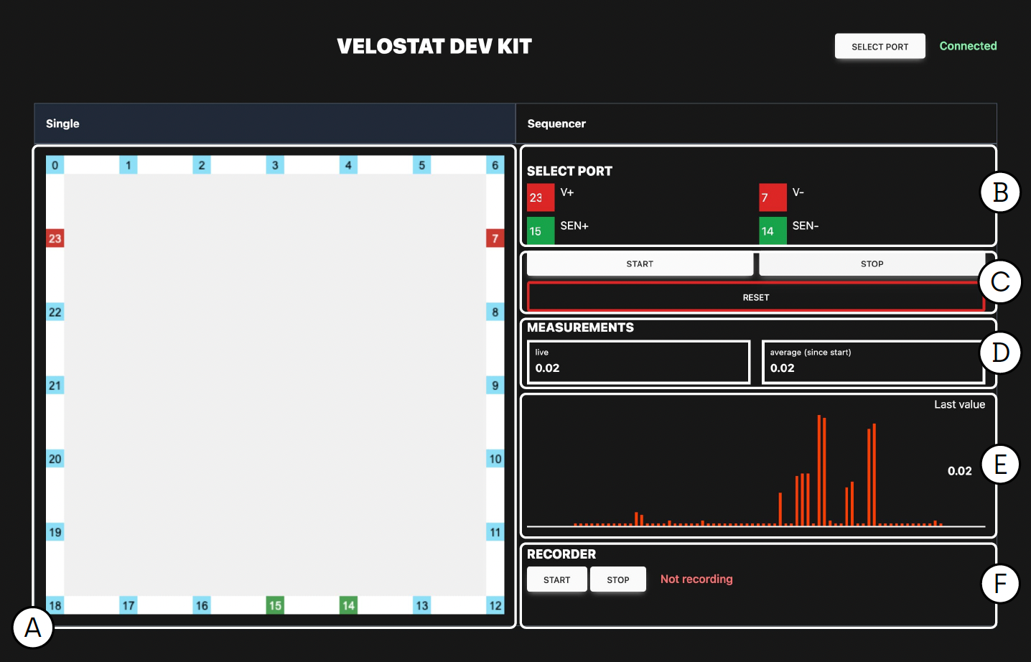
Web Visualisation
Implementation and Design
Notes:
Single mode
Check velostat reaction
Enables us to change one parameter of the testing an evaluate quickly

Slide 13
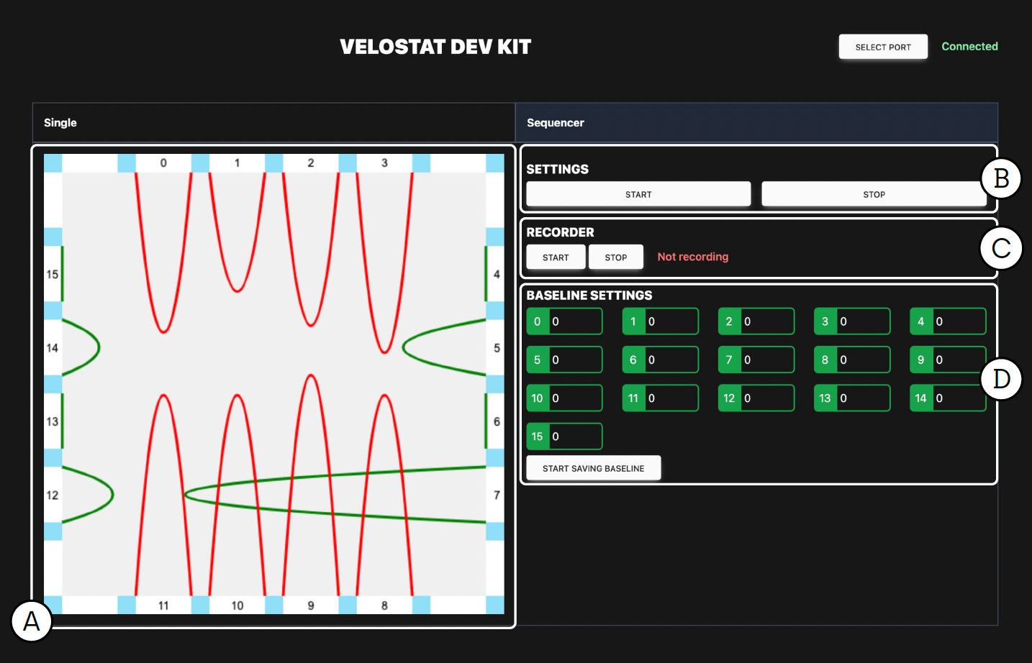
Web Visualisation
Implementation and Design
Notes:
Sequencer mode

Slide 14
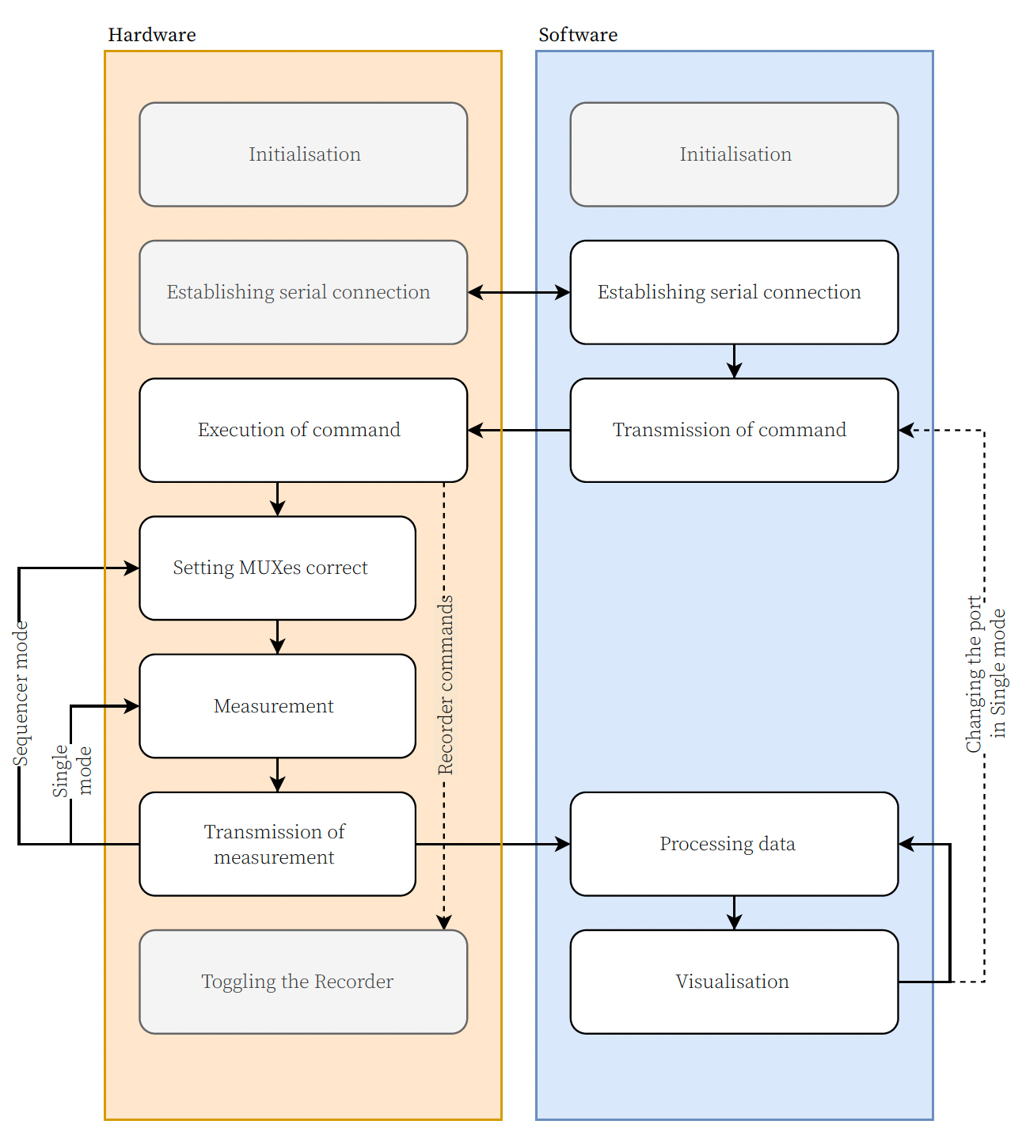
Interaction flow
Implementation and Design

Slide 15
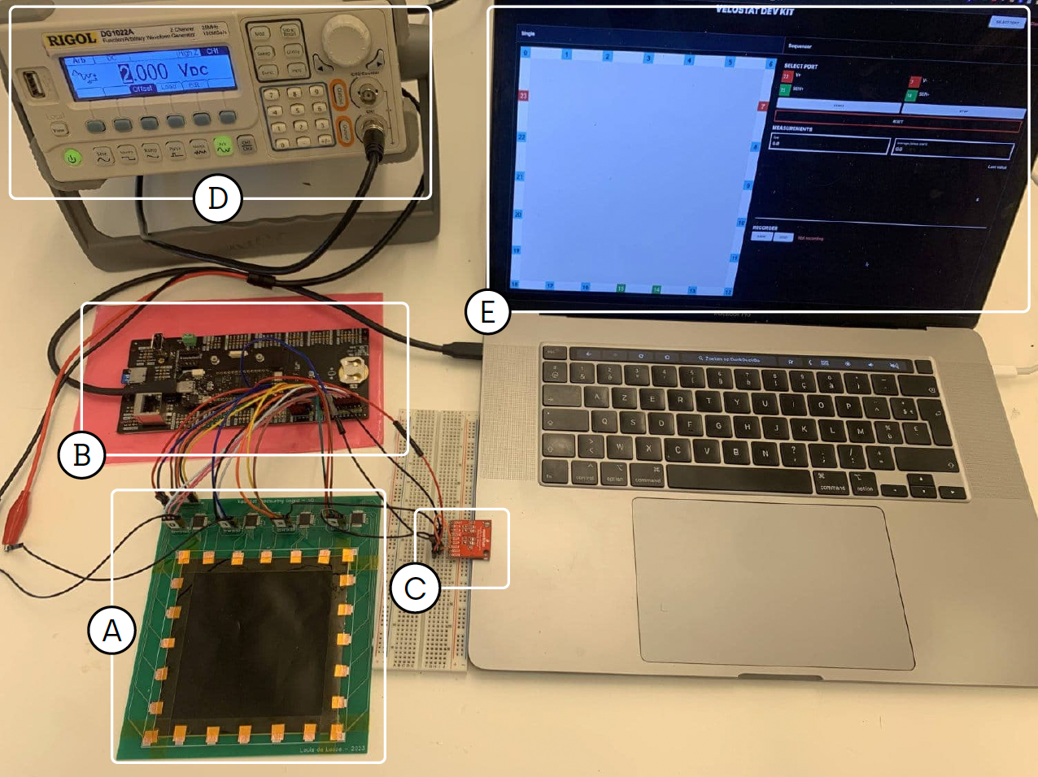
Complete System
Results

Slide 16
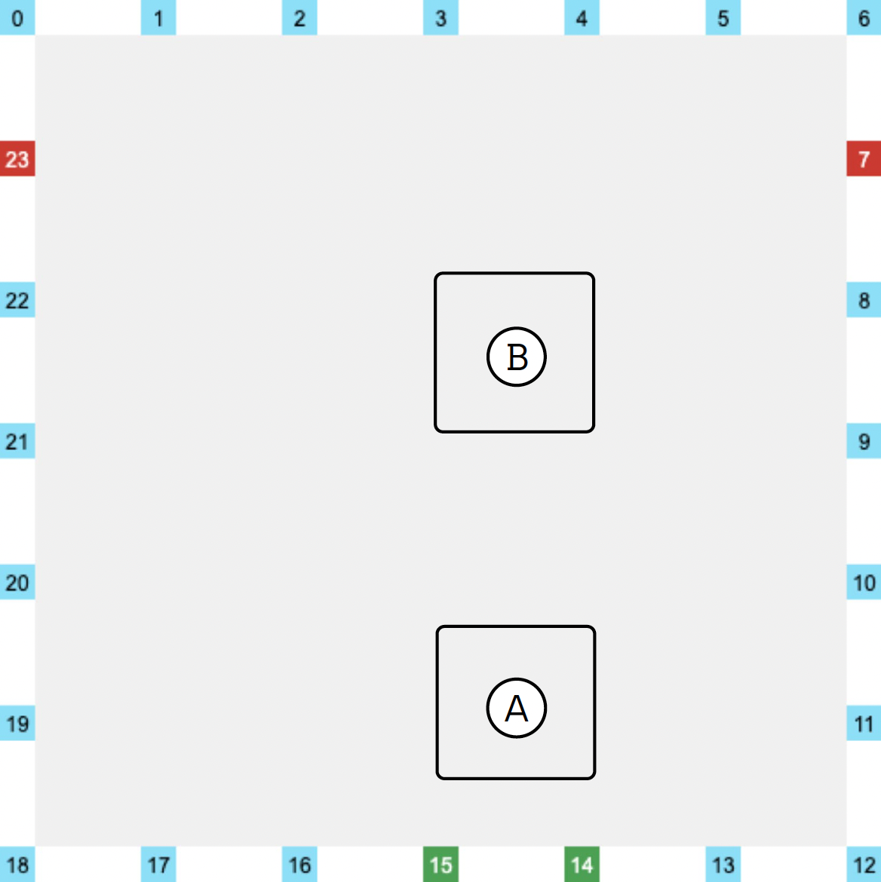
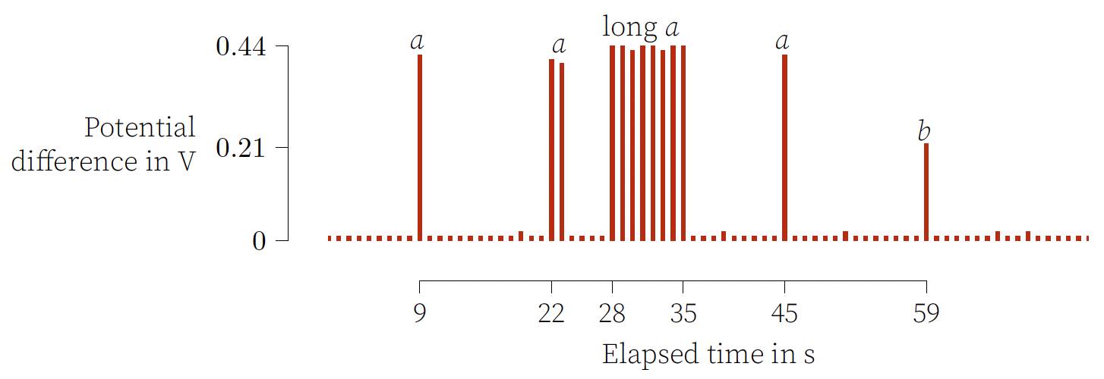
Single Mode
Results

Slide 17
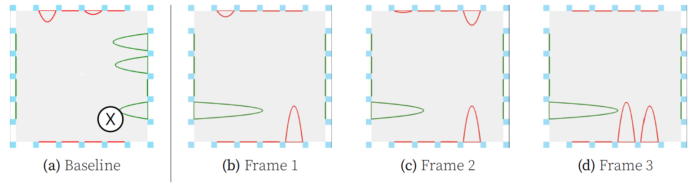
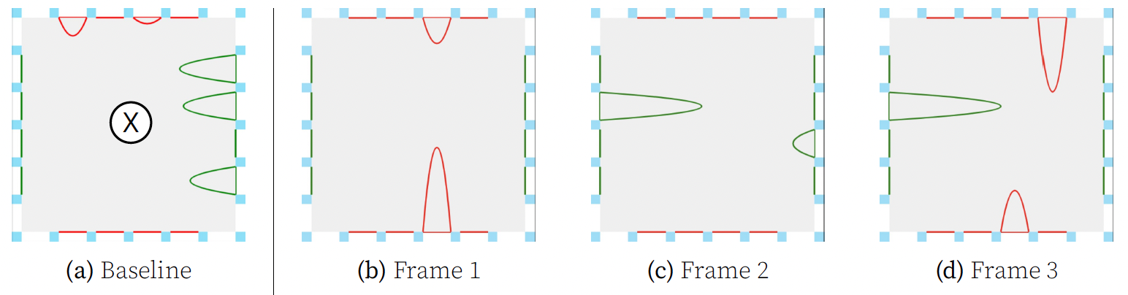
Sequencer Mode
Results

Slide 18
- video in folder -
Results
Notes:
Image: https://www.adafruit.com/product/1361

Slide 19
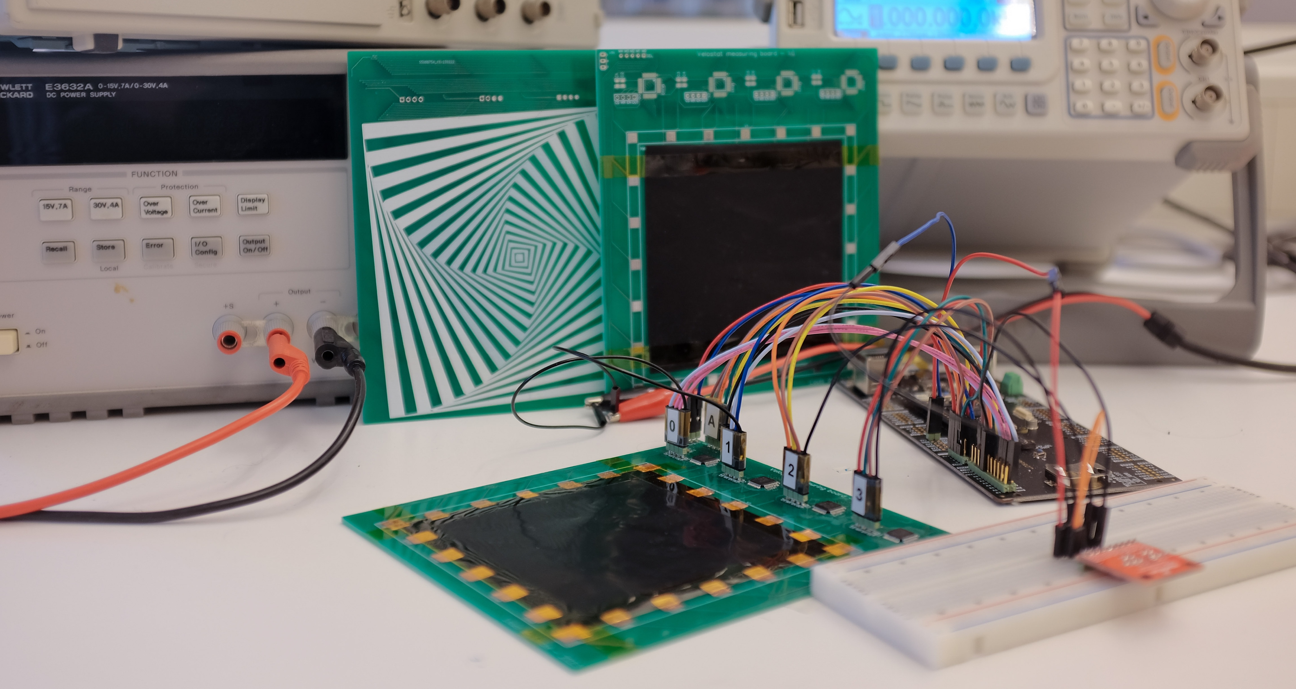
Conclusion
Notes:
Image: https://www.adafruit.com/product/1361

Slide 20
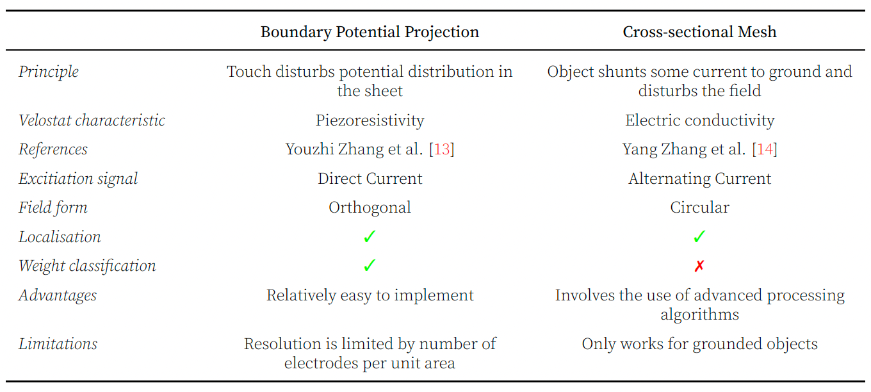
Extra
Notes:
Image: https://www.adafruit.com/product/1361

Slide 21
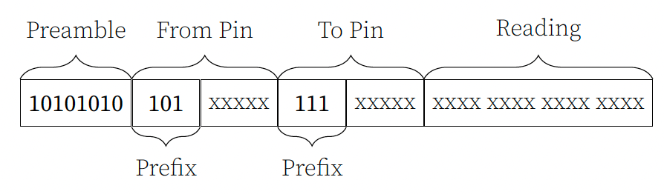
Extra
Notes:
Image: https://www.adafruit.com/product/1361

Slide 22
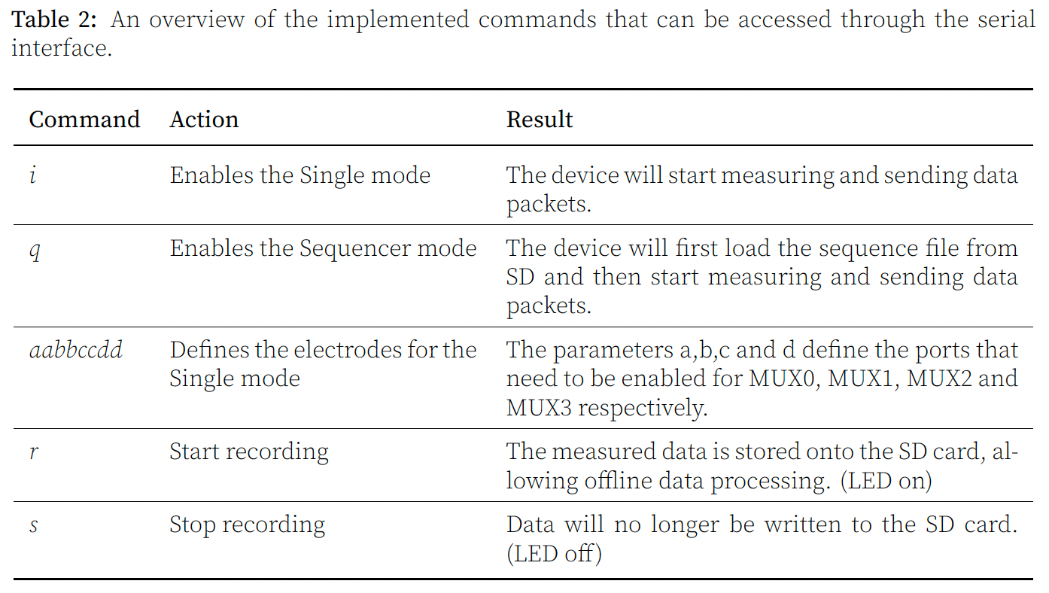
Extra
Notes:
Image: https://www.adafruit.com/product/1361

